Slide 1
IoT Based Patient Monitoring System
No. | Name | Roll No. | Univ. Roll No. | Univ.Reg. No.
1 | RISHU RAJ | B-76 | 10400315117 | 151040110461
2 | CHANDAN SINGH | B-105 | 10400315054 | 151040110398
Under the Guidance of:
PROF. SUTAPA RAY ADHIKARY

Slide 2
Contents
Introduction
Equipment used
Circuit Diagram
Results
Future Enhancements
Conclusion
References

Slide 3
Introduction
Health monitoring is the major problem in today’s world. Due to lack of proper health monitoring, patient suffer from serious health issues. There are lots of IoT devices now days to monitor the health of patient over internet. Health experts are also taking advantage of these smart devices to keep an eye on their patients.
Here in this project, we will make an IoT based Health Monitoring System which records the patient heart beat rate and body temperature and also send an email/SMS alert whenever those readings goes beyond critical values.Pulse rate and body temperature readings are recorded over ThingSpeak and Google sheets so that patient health can be monitored from anywhere in the world over internet.

Slide 4
Equipments Needed
1. Arduino Uno
2. ESP8266 Wi-Fi module
3. LM35 temperature sensor
4. Pulse rate sensor
5. Push button
6. 10k Resistor
7. Male-female wires
8. Breadboard

Slide 5
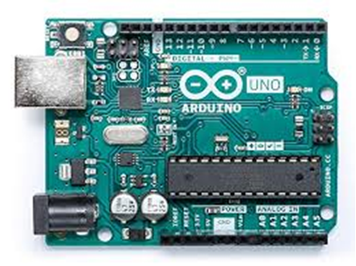
Arduino Uno
Arduino Uno is a microcontroller board based on the ATmega328P. It has 14 digital input/output pins of which 6 can be used as PWM outputs, 6 analog inputs, a 16 MHz quartz crystal, a USB connection, a power jack, an ICSP header and a reset button. The sensors are powered from the Arduino Uno. It has 14 digital input/output pins of which 6 can be used as PWM outputs, 6 analog inputs, a 16 MHz quartz crystal, a USB connection, a power jack, an ICSP header and a reset button.

Slide 6
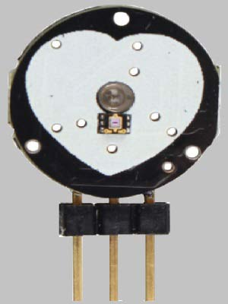
Pulse Rate Sensor
Pulse Sensor is a well-designed plug-and-play heart-rate sensor for Arduino. The sensor clips onto a fingertip or earlobe and plugs right into Arduino. It also includes an open-source monitoring app that graphs your pulse in real time.

Slide 7
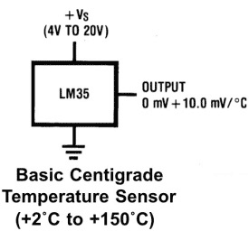
LM35 Temperature Sensor
LM35 is a analog linear temperature sensor. Its output is proportional to the temperature (in degree Celsius). The operating temperature range is from -55°C to 150°C. The output voltage varies by 10mV in response to every of rise or fall in temperature. It can be operated from a 5V as well as 3.3 V supply and the stand by current is less than 60uA.

Slide 8
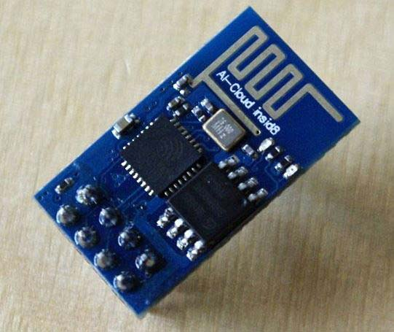
ESP8266
ESP8266 is the name of the micro-controller developed by Espressif Systems which is a company based out of shanghai. This micro-controller has the ability to perform WIFI related activities hence it is widely used as a WIFI module.

Slide 9
ThingSpeak
Thingspeak is an open source IoT application and API. It helps to store and retrieve data from things using the HTTP protocol all over the internet or from the local area network (LAN). It allows its users to use MATLAB which they integrated to analyze and visualize the uploaded data without purchasing the license. Thingspeak was written in ruby, has a Cross-Platform operating system and stores it’s data in cloud. A user can have a free sign in Thingspeak and after signing can open up unlimited channel under that account. Each channel has different fields and in those fields data’s are displayed in graphical forms. User can analyze the data according to the need using the MATLAB. Another important feature of Thingspeak is it provides a react option to its users. The react option helps to give an instant reaction to the concerning authority whenever a definite condition is fulfilled via social networking site Twitter and even e-mail as well.

Slide 10
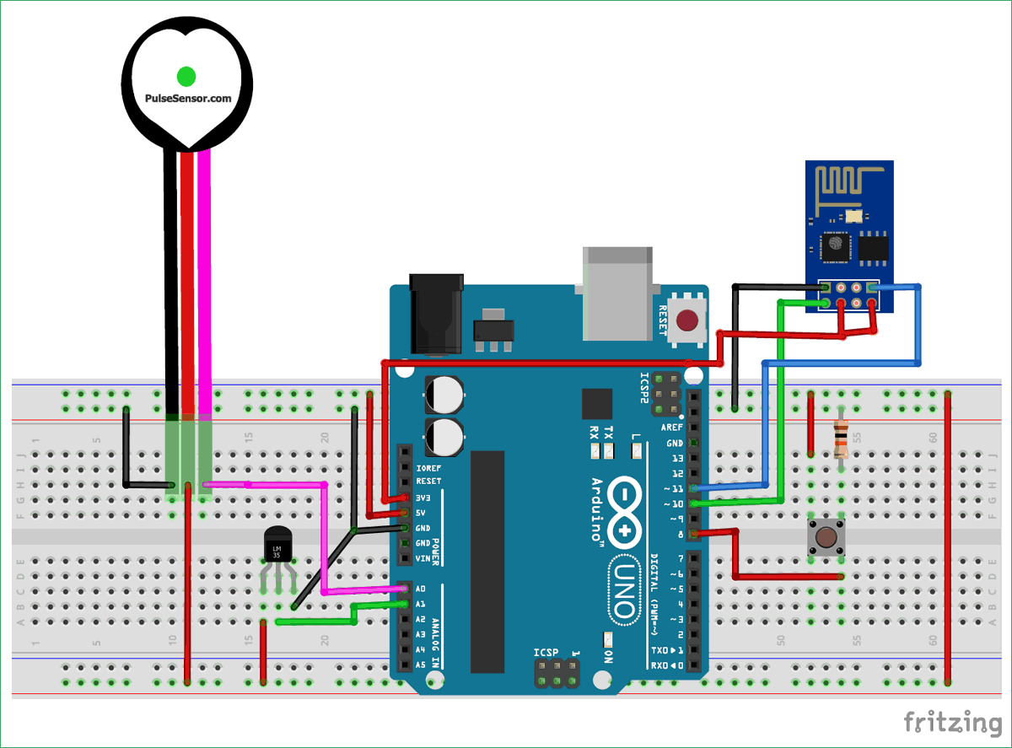
Circuit Diagram

Slide 11
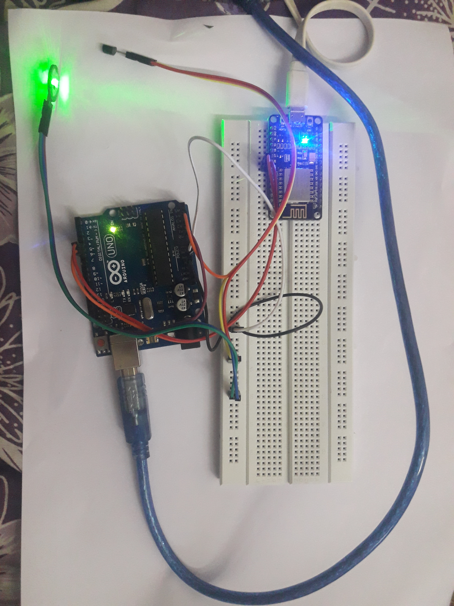
Patient Monitoring System in Action

Slide 12
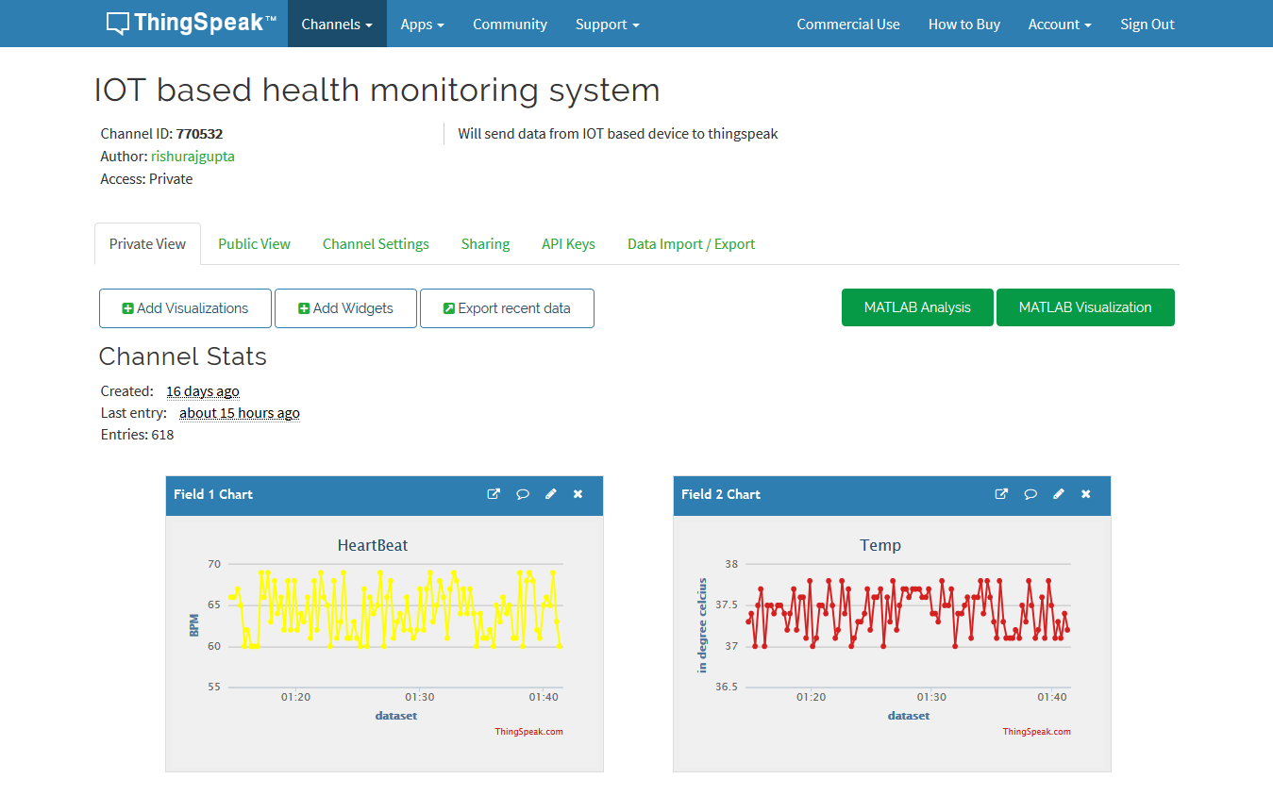
Results

Slide 13
Alert

Slide 14
Future Extensions:
As more number of sensors are developed then by using them we can get more information about the patient’s health.
By setting this arrangement to a mass scale one can develop a network of these devices, that will help the person-in-charge to remotely monitor all patients and provide medical aid to them.
With the development of Artificial Intelligence in future all these process can be automated so that human dependencies can be removed.

Slide 15
Conclusion
Our main objective in this project was to successfully monitor the basic criteria’s namely temperature, pulse and react during emergency situation without any human interaction. With the rise of IoT, the era of technology is moving towards a far superior dimension. In order to keep pace with the new technologies, this project can sure make way for the advancement in this sector. Though our model is tested and implemented, it will be difficult to continue the project without superior quality hardware support along with a lot of new integration. The real benefit of this work can only be fully realized when it can be implemented in full scale.

Slide 16
REFERENCES
[1] Brock, D. L. (2001). The electronic product code (epc). Auto-ID Center White Paper MIT-AUTOID-WH-002.
[2] Ni, Q., García Hernando, A. B., & de la Cruz, I. P. (2015). The elderly’s independent living in smart homes: A characterization of activities and sensing infrastructure survey to facilitate services development. Sensors, 15(5), 11312-11362.
[3] Himadri Nath Saha; Supratim Auddy; Subrata Pal; Shubham Kumar; Shivesh Pandey. Health monitoring using Internet of Things (IoT) by 2017 8th Annual Industrial Automation and Electromechanical Engineering Conference (IEMECON).
[4] Jorge Gómez,Byron Oviedo,Emilio Zhuma. Patient Monitoring System Based on Internet of Things
[5] S.F. Khan. Health care monitoring system in Internet of Things (IoT) by using RFID.

